Slide 1
Human Trafficking in Maryland
Amanda K. Rodriguez, Esq.
Manager of DV & Human Trafficking Policy
Governor’s Office of Crime Control & Prevention

Slide 2
What is Human Trafficking?
And why should we care?

Slide 3
Federal v. State Definitions
Federal Definition State Definition
The recruitment, transportation, transfer, harbouring or receipt of persons, by means of the threat or use of FORCE or other forms of COERCION, of abduction, of FRAUD, of deception, of the abuse of power or of a position of vulnerability or of the giving or receiving of payments or benefits to achieve the consent of a person having control over another person, for the purpose of exploitation
To take, place, persuade, induce, entice, or encourage another to be taken to or placed in any place for prostitution;
To receive consideration to procure for or place in a house of prostitution or elsewhere another with the intent of causing the other to engage in prostitution or assignation;
To engage in a device, scheme, or continuing course of conduct intended to cause another to believe that if the other did not take part in a sexually explicit performance, the other or a third person would suffer physical restraint or serious physical harm; or
destroy, conceal, remove, confiscate, or possess an actual or purported passport, immigration document, or government identification document of another.

Slide 4
Domestic Trafficking
3 Step Process
Recovery Methods

Slide 5
Trafficker’s Manipulation
Identify the need of the child (victim).
Fulfill the need.
Remove any other sources of need fulfillment.
Exploit the child’s dependence for need fulfillment by forcing them into prostitution.
http://sharedhope.org/2013/04/10/why-her-what-you-need-to-know-about-how-pimps-choose/

Slide 6
“You’ll start to dress her, think for her, own her. If you and your victim are sexually active, slow it down. After sex, take her shopping for one item. Hair and/or nails is fine. She’ll develop a feeling of accomplishment. The shopping after a month will be replaced with cash. The love making turns to raw sex. She’ll start to crave intimacy and be willing to get back into your good graces. After you have broken her sprit, she has no sense of self value. Now pimp, put a price tag on the item you have manufactured”
The Pimp Game: An Instructional Manual (Royal, 1998)

Slide 7
Trafficker’s Methods of Control
Threats against victim and or victim’s family
Physical and sexual abuse
Isolation and confinement, restrict contact with outside world
Seize or destroy documents
Prevent trafficked person from earning enough to pay off debt, keep adding charges to debt
Drug or alcohol dependency
Make victim think he/she will be arrested if he/she leaves the situation
Psychological abuse and manipulation including tactics to create dependency
Use shame and self-blame against victim

Slide 8
National Statistics
600,000 to 800,000 are trafficked world wide each year
  Estimates are as high as 27 million per year
  The world-wide industry earns $150.2 billion per year
  This is now the 2nd highest grossing criminal enterprise
14,500 to 17,500 are trafficked into the US each year
200,000 are estimated to be trafficked within the US

Slide 9
Statistics
2013 – 217 survivor were identified by victim services groups in Maryland; Law enforcement identified hundreds of survivors.
2013 – Number 8 in the Country – 707 calls of trafficking
At least 244,000 children are at risk for sex trafficking each year - NCMEC
The children are targeted and trafficked is between the ages of 12-14 years old - U.S. Department Of Justice
Within 1/7 of runaways will be solicited for prostitution -NCMEC

Slide 10
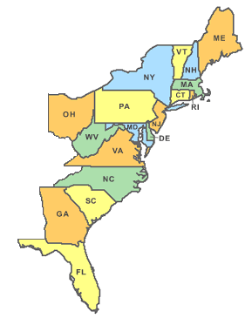

Slide 11
2007 to Present
Increase in Identification in Male Trafficking Victims
Increase in MS-13 Gang Activity in Latin Brothels
Emergence of Identification of “Survival Sex”
Connection Between Foster Care and Human Trafficking
New Law Enforcement Techniques
Transgender Victimization
Movement From Craigs List to Backpage
Emergence of “John” forums
Multi-Disciplinary Team Approach
Labor Trafficking

Slide 14
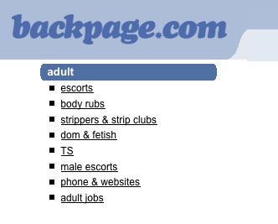
Local Investigations
Is there really trafficking in Maryland?

Slide 16
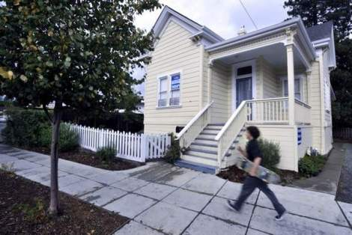
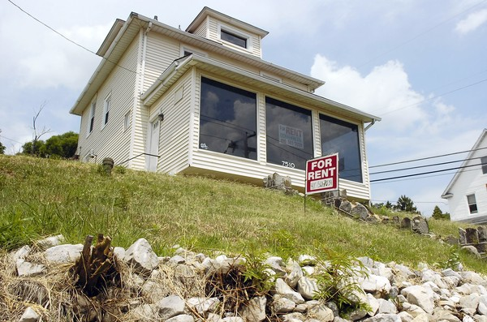
York Road Red Light District
“If you build it, they will come…”

Slide 17
What Do I Do Now?
Amanda Rodriguez
410-821-2829
301-802-0462
arodriguez@goccp.state.md.us
Hotline 888-3737-888
MDHumanTrafficking.org

